Slide 1

Executive Summary
Accountability Framework Overview
Facility Accountability Frameworks
System Accountability Frameworks
How to Implement an Accountability Framework
Accountability Frameworks
Root Causes
Inflow
Throughput
Outflow
Overcapacity Protocols
Leadership: Essential Knowledge
Reducing Delays in Your Hospital
Teaching Materials
Healthcare Stories
References
Operational Improvement Resources
Home Page
(NPLB)
Intake Areas & Low-Acuity Diversion
Accountability Strategies: Overview
Rationing and Ethical Allocation
The One vs. the Many
Matching Demand & Capacity
Reducing Variability
Task Shifting
Operational Improvement Strategies
Applications
& Awards
Award Application Form
Award Evaluation Criteria
Funding Priorities
Application Submission Link
Submitted Project List
Funded Project Summaries
Donate Link
Level 1
Level 2
Level 3
Level 4

Slide 2
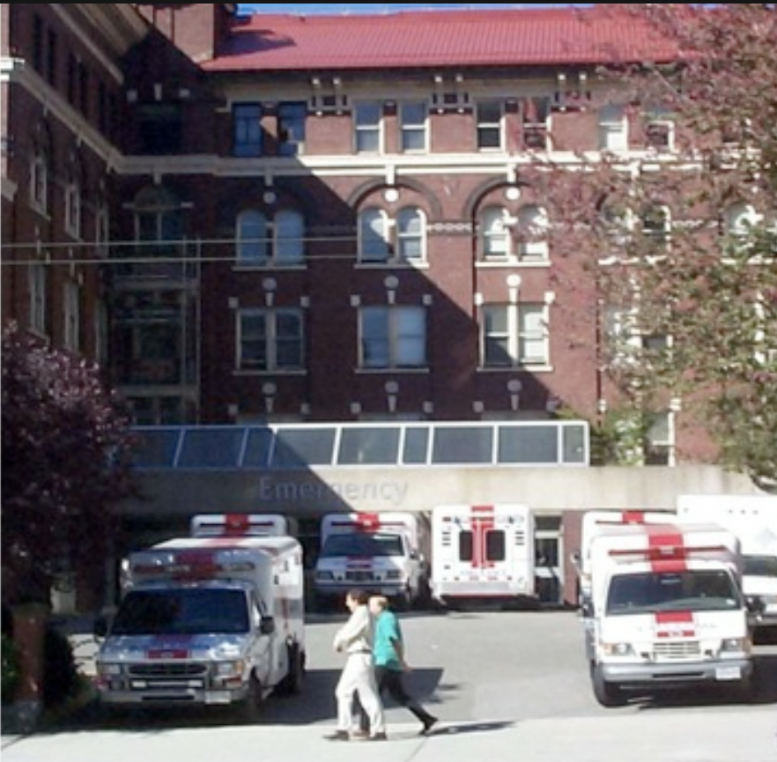



No Patient Left Behind
The Grant Innes Health Endowment Fund
Canadians face long delays to access primary care, specialist care, hospital care, long-term care, and surgical care. As a result, Canada leads wealthy nations in emergency department use, which has left ERs overwhelmed and unable to provide timely emergency care. Health experts believe that increasing system efficiency could reduce patient waiting times by 30% to 50%. Following a recent pancreatic cancer diagnosis, Dr. Innes launched the "No Patient Left Behind" health endowment fund to ensure his work on the healthcare crisis continues. The fund aims to reduce care delays in hospitals and communities using three main strategies: teaching healthcare staff and managers more efficient care delivery methods; supporting visionary leaders focused on healthcare improvement; and Implementing clear policies and accountability standards to assure faster, high-quality care.
If materials on this site were helpful, please consider a tax deductible donation to the No Patient Left Behind Fund
Donation Link
Why “No Patient Left Behind.”
Who are we?
Our Mission
Improvement Resources
Improvement Strategies
Accountability Frameworks
Awards and Applications
Education Links

Slide 3
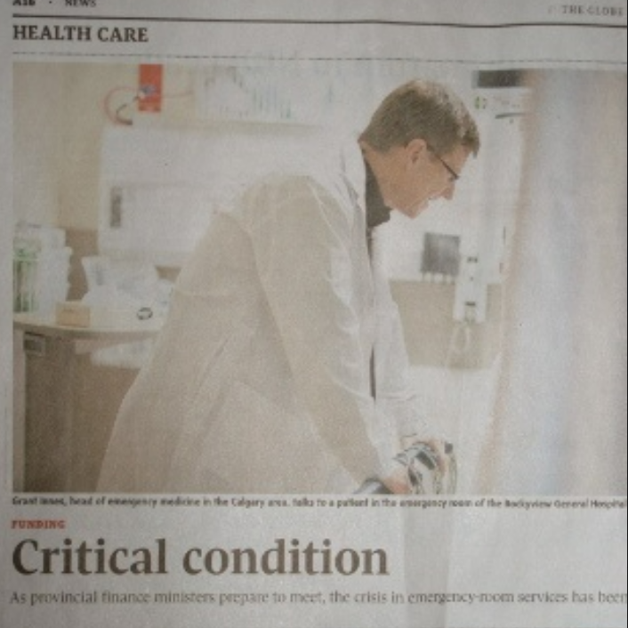
No Patient Left Behind
The Grant Innes Health Endowment Fund
Canadians Struggle to Get Healthcare: Canada uses emergency departments more than any other wealthy nation. This isn't because people prefer the ED; it's because they face long delays everywhere else—from finding a family doctor or specialist to getting a hospital bed, long-term care, or routine surgery. Health experts believe that by making our healthcare system more efficient, we can cut these waiting times by 30% to 50%.
Dr. Innes’ work focuses on solutions for the growing crisis in emergency care. A diagnosis of pancreatic cancer, and the hope that his work could continue, motivated him to launch the “No patient Left Behind” health endowment fund. Its mission is to reduce care delays in hospitals and communities by supporting visionary leaders who are dedicated to system improvement, by training doctors, nurses, and managers in more efficient ways to deliver patient care, and by introducing clear hospital policies and accountability standards to ensure patients get the fast, high-quality care they deserve.
Donation Link
If the information on this site was helpful, please consider making a tax-deductible donation
Why “No Patient Left Behind.”
Who are we?
Our Mission
Improvement Resources
Improvement Strategies
Accountability Frameworks
Awards and Applications
Education Links

Slide 4
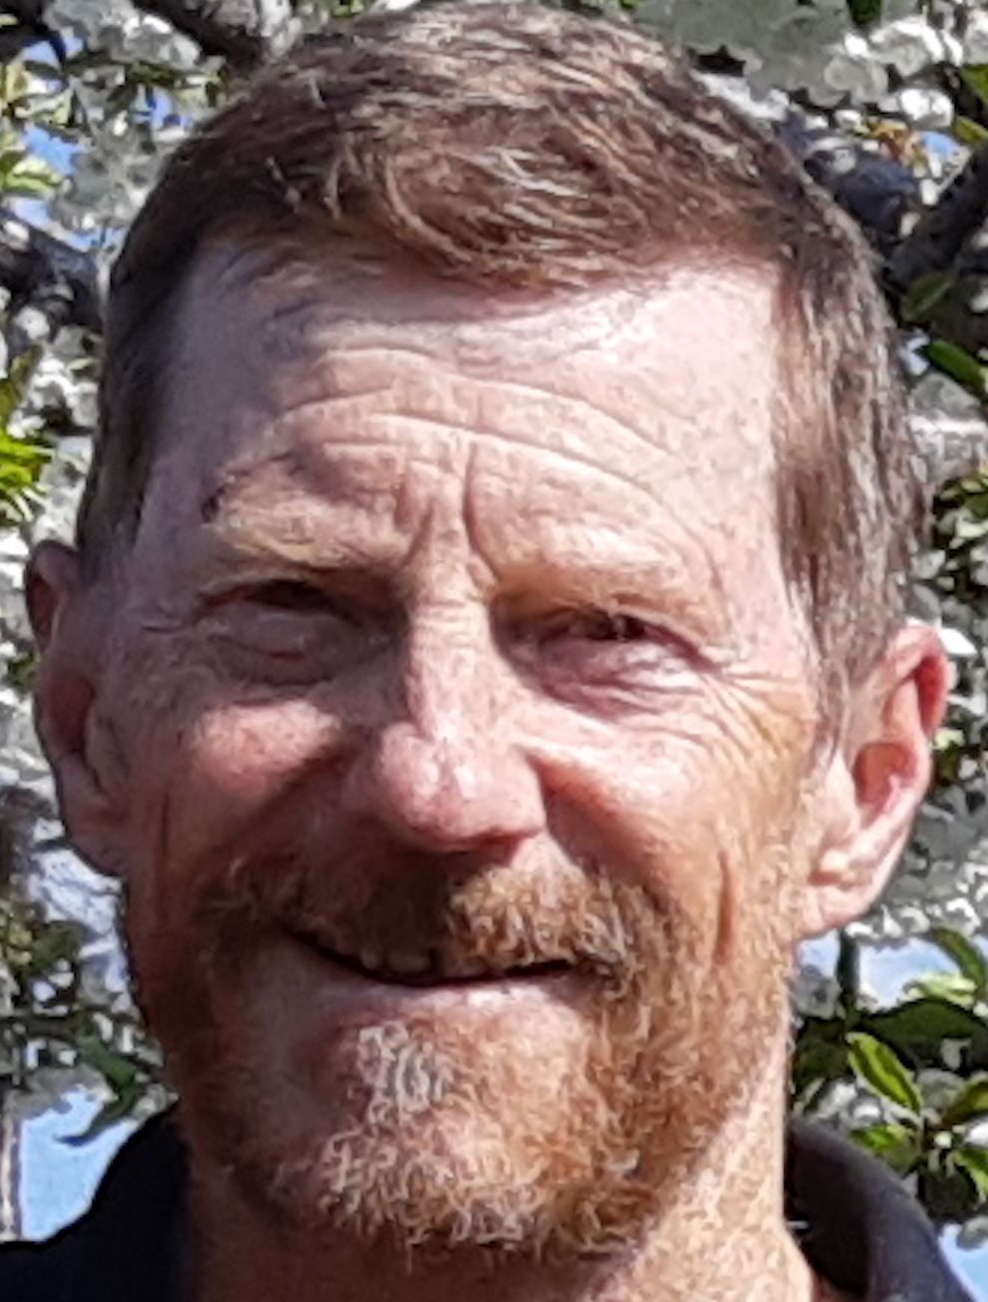

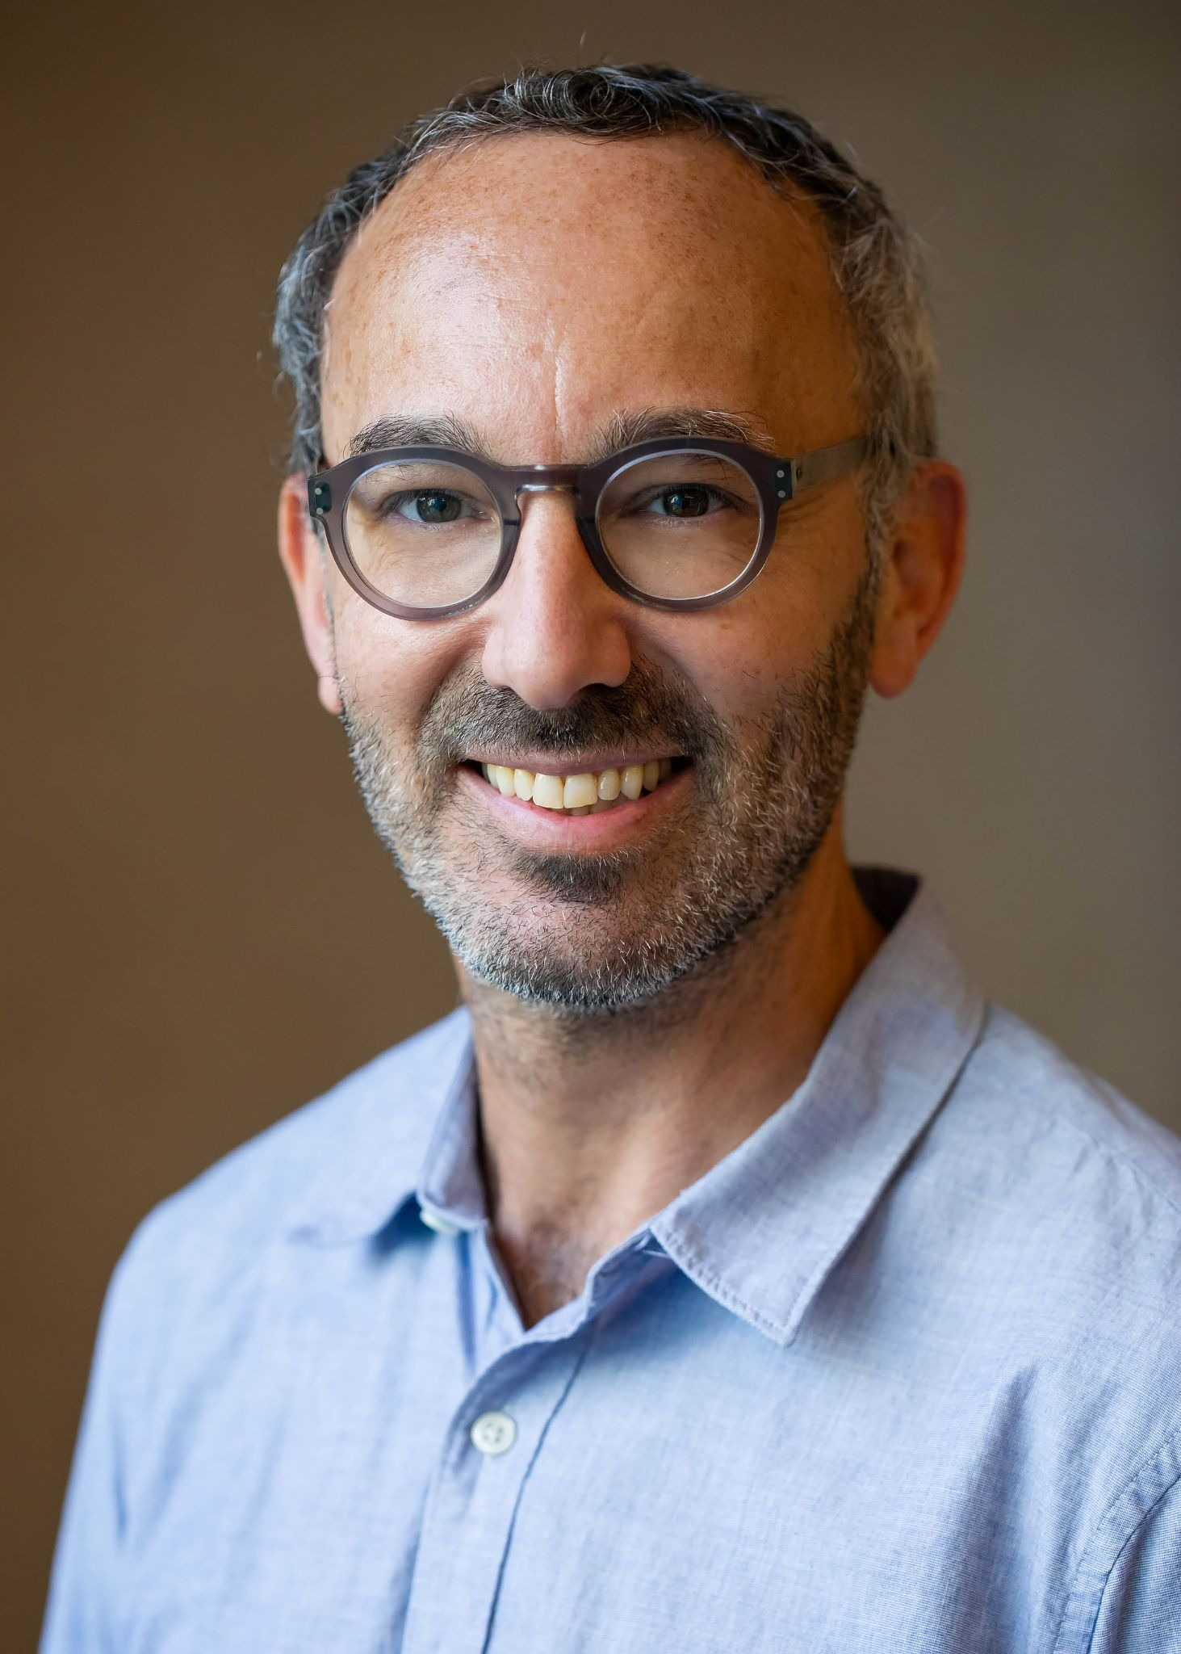
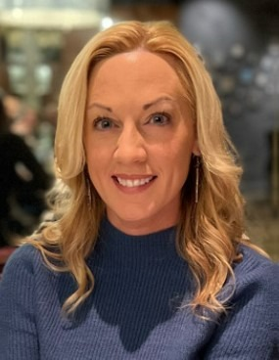
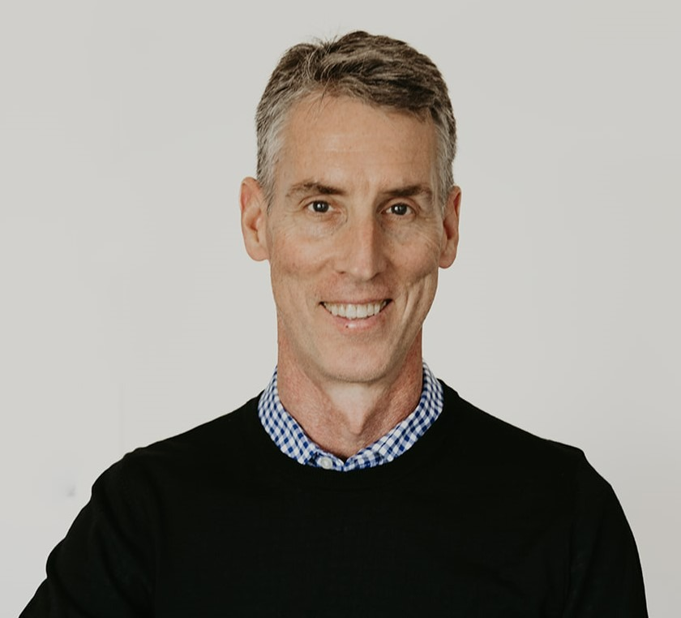
Dr. Innes worked 42 years as an emergency physician in Calgary, Vancouver and Oliver, BC. He previously served as chair of Vancouver Coastal Health Emergency Services, Professor of Emergency Medicine at the University of Calgary, founding editor of the Canadian Journal of Emergency Medicine, and a senior author of the recent EMPOWER Report on the Future of Emergency Medicine. He is an expert in emergency care and has led large-scale system change in two provinces. He has received many awards for health quality, innovation and lifetime contributions to Emergency Medicine. Dr. Innes believes current care delays can be substantially reduced by introducing accountability frameworks and operational improvements. His recent diagnosis of pancreatic cancer, and the hope his work could continue in the future, motivated him to launch the “No patient Left Behind” health system endowment fund, which will support future development of healthcare improvement strategies and system accountability measures to increase patient access to appropriate care.
Who Are We (the Board)
Dr. Anton Helman is an emergency physician at North York General in Toronto. He is an Assistant Professor at the University of Toronto, Division of Emergency Medicine and the Education Innovation Lead at the Schwartz-Reisman Emergency Medicine Institute. He is the founder, editor-in-chief and host of Emergency Medicine Cases
Dr. Shelley McLeod is a Clinical Epidemiologist and the Research Director of the Schwartz/Reisman Emergency Medicine Institute (SREMI) at Sinai Health and an Associate Professor in the Dept of Family and Community Medicine and the Institute of Health Policy, Management and Evaluation at the University of Toronto. Dr. McLeod has over 20 years experience in emergency medicine research, and has authored more than 155 publications across a wide range of emergency medicine topics. Her interests include emergency department triage and patient flow, evidence synthesis clinical trial design, and program evaluation
Dr. Sutherland is the Director of the Centre for Health Services and Policy Research (CHSPR) and is the UBC Professor of Health Services and Policy in the University of British Columbia’s School of Population and Public Health (SPPH). He has been leading policy and health services research in two domains: health care funding policy and variations in patients’ health status attributable to health services. Dr. Sutherland has extensive collaborative relationships with health services researchers, decision-makers and clinicians across Canada, the US and Europe. Dr. Sutherland provides advice and recommendations on health system funding policies to a number of Canadian governments

Slide 5
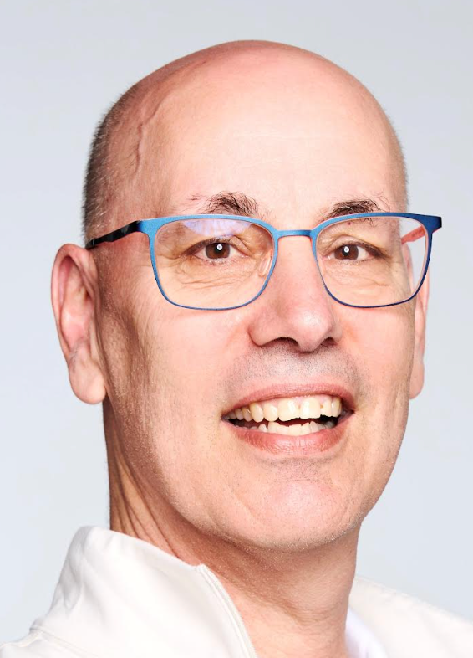
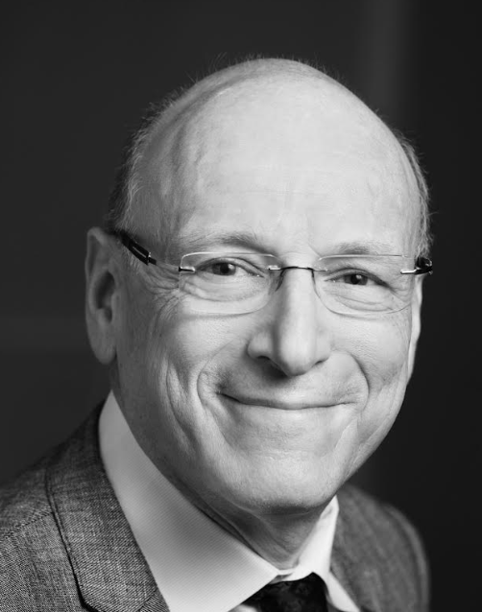

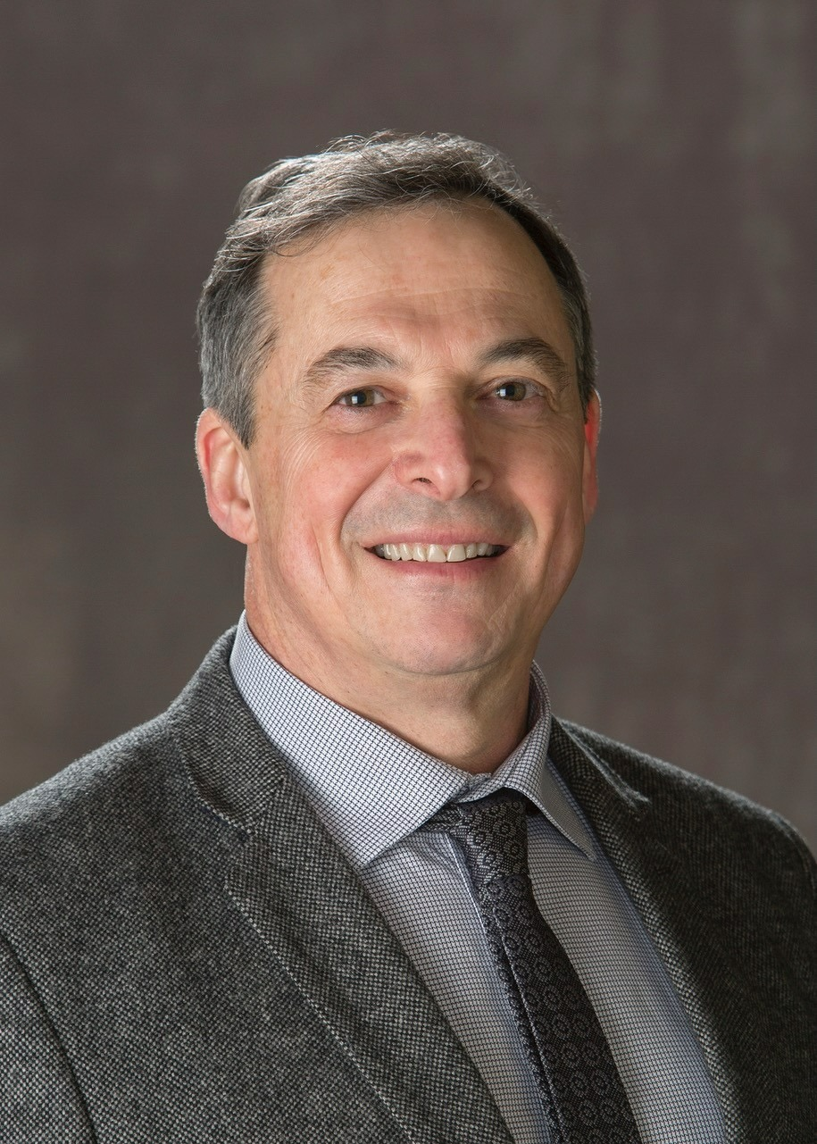
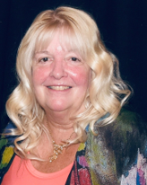
Dr. Eric Grafstein completed Medical School at the University of Toronto in 1985 and completed his Emergency Medicine training at McGill in 1991. He has been practicing as an Emergency Physician in Vancouver for over 30 years. Eric was the Regional Head of Emergency Medicine at Vancouver Coastal Health - Providence Health Care from 2012 to 2026. He currently serves as the Regional Chief Medical Information Officer and the Chief Medical Analytics Officer.
Dr. Howard Ovens is an emergency physician and the Chief Medical Strategy Officer of Sinai Health, and Medical Advisor to Sinai Health Foundation. He is a Full Professor at the University of Toronto Dept. of Family and Community Medicine and a Senior Fellow in the Institute of Health Policy, Management and Evaluation. He is Medical Lead for the Ontario Health Provincial Emergency Services Program and a member of the Public Affairs Committee of the Canadian Association of Emergency Physicians. Dr. Ovens tweets about administration and public policy issues related to emergency services using the handle @HowardOvens. His blog “Waiting to be seen” is hosted on the Emergency Medicine Cases website. In 2025 he was invested into the Order of Ontario.
Who Are We (the Board)
Emma Helman is a medical student at Schulich School of Medicine. She has an undergraduate degree at McGill University and is currently pursuing a Master’s in Population Health Sciences at the University of Cambridge, where her work focuses on system and practice improvements in community palliative care. She is passionate about health policy advocacy aimed at improving system level access and quality of care. Her goal is to participate right care, right time policy development.
Sherry Stackhouse is a career emergency nurse, da da da da . . . emergency medicine at the University of Manitoba. He is a past president of the Canadian Association of Emergency Physicians (CAEP) and previousl department head and specialty lead for Emergency Medicine in Manitoba. He was senior author of CAEP’s EM:POWER report on the future of emergency medicine and has an ongoing interest in health
Dr. Alecs Chochinov is a professor of emergency medicine at the University of Manitoba. He is a past president of the Canadian Association of Emergency Physicians (CAEP) and previousl department head and specialty lead for Emergency Medicine in Manitoba. He was senior author of CAEP’s EM:POWER report on the future of emergency medicine and has an ongoing interest in health policy and system redesign.
Lynn Garrow has been the Executive Director of The Canadian Association of Emergency Physicians for the last 10 years. Before that, she held many senior executive roles in the Federal Public Service, including Executive Director of the Correctional Service of Canada, CEO of CORCAN and Assistant Commissioner of Performance Assurance. Lynn holds an undergraduate degree in Criminology and a Masters of Business Management from Northwestern University.
Notes:
Second level links

Slide 6

Executive Summary
Accountability Framework Overview
Accountability Frameworks
Hospital Accountability Frameworks
System Accountability Frameworks
How to Implement an Accountability Framework

Slide 7
Other board members and pictures
Who Are We (the Board)

Slide 8
Our Mission
Mission: To support the development and implementation of health system innovations that improve patient access to appropriate (right care, right place) care in emergency departments, hospitals or communities. To be recognized as a system improvement catalyst, policy advocate, and trusted information source for health leaders.
Objective: The purpose of the No Patient Left Behind fund is to provide annual peer-reviewed funding awards to develop and implement promising access-related health system innovations, particularly those that incorporate concepts of patient care accountability or accountability framework implementations. High priority grant proposals could fall into several categories (see Funding priority areas).
Funding: Funding would arise through the No patient left behind endowment fund. The fund will award annual system improvement grants that are divisible based on the quality and potential impact of the applications (as determined by the board or a grant review committee). Successful grants would be awarded at the Canadian Association of Emergency Physicians (CAEP) annual conference; they would acknowledge the SREMI/CAEP/“No Patient Left Behind” collaboration and specifically name the Grant Innes “No Patient Left Behind” fund and its mission. Growing awareness of the fund through CAEP, SREMI, the oversight committee, and a “No Patient Left Behind” giving campaign will hopefully lead to ongoing donations from the community.
Who Are We (the Board)

Slide 9
Why do we need “No Patient Left Behind?”
Canada ranks near the bottom among high-income countries for timely access to primary care, specialist care, hospital services, community care, and elective surgery. These access gaps create bottlenecks throughout the system, driving patients to emergency departments (EDs), which function as the system’s universal contingency plan and only open door. As a result, Canada has the highest ED utilization rate of all high-income countries. When patients receive care in the wrong setting or experience prolonged delays, outcomes worsen. Frail older adults awaiting community care often remain in acute-care hospital beds for weeks, causing cognitive decline, deconditioning and subsequent institutionalization. These “ALC patients” limit hospital capacity and delay inflow from the ED. As a result, admitted patients waiting for inpatient ward beds are held, often for days, in noisy ED stretchers with suboptimal care, poor sleep and limited bathroom access, factors that drive prolonged hospital lengths of stay (LOS). Inpatients accumulate in ED stretchers and prevent ED inflow, forcing seriously ill arrivals to waiting areas where they face long waits, untreated pain, clinical deterioration and, too often, disastrous outcome.
The causes: Canada faces real capacity challenges, including physician shortages, a relative paucity of hospital beds, and an aging population with increasing healthcare needs, but capacity is not the only concern. A fundamental issue is the lack of program accountability for patient access and system flow. While providers have a general understanding that they should try to reduce care delays, there is no expectation they will do so, nor consequences for failure. In the face of rising demand and growing care delays, programs might choose to initiate difficult system innovation but, in our system, it is also acceptable to continue usual processes and restrict access when it seems necessary. The latter approach is more intuitive, and management by closing doors delivers huge rewards. Workload is controlled, waiting patients out of sight and out of mind, staff stress relieved, and budgetary challenges mitigated. Care shortfalls become someone else’s problem and programs are protected from evolutionary stressors that would otherwise mandate change and innovation.
Solutions: This is system failure, not provider failure, and we have two main recommendations: operational improvement and accountability frameworks. Operations researchers suggest that process optimization can increase flow and throughput by 30-50%. In contrast, a large Canadian ED study found that even small 2-4% hospital flow enhancements would enable EDs to rapidly manage all high acuity patients and eliminate waiting room deteriorations. Innovation and process improvement will not assure the right care in the right place for all patients, but they will reduce wait times and eliminate most emergency access blocks.
Accountability frameworks are critical but oddly rare in healthcare. They specify accountability zones (which program is most responsible for which patients) and they define program expectations, including timely care access and the need for effective queue management and surge strategies. Without defined accountability zones and care expectations, an acceptable program response to care gaps is, “Sorry, we’re full” (i.e. join the queue). In an accountable system, program leaders would instead ask, “How can we change our systems if closing the door is not an option?
Most doctors, nurses and health agree with accountability as a concept. Unfortunately, they often believe accountability is impossible because of resource limitations, or too many ALC patients, or too many boarding inpatients. They often protest that they are already doing everything possible, and that “you can’t just push more patients into a full system!”
Facing these perceived barriers, it is worth asking program leaders about:
-Strategic planning: Is your team aware of your accountability zone (your queuing patients);
-Innovation: Ask your teams, How would you change if closing the door was not an option?
-Utilization: Yes you are full, but do all the patients need a hospital bed/ED stretcher?
-Rationing: Are you prioritizing patients with greatest need, or are some of the sickest outside?
-Operations/flow: Are you smoothing? fixing bottlenecks? admitting-discharging 7 days/week?
-Do you have non-value added processes, redundant care, avoidable testing, consult delays?
-Are you matching demand to capacity and reducing variability?
-Do you have a demand-driven overcapacity plan?
-Could you explore new staffing models and expanded scopes to increase care capacity?
-Have you fixed bottlenecks and unloaded bottleneck providers?
-Are you triaging and reverse triaging to assure ethical allocation?
-Do you have goals/targets for flow and access?
Very few programs have exploited all available improvement opportunities, and substantial optimization is possible. No Patient Left Behind can make a difference by promoting and supporting operational innovation, by developing effective leaders, and by driving policy change that leads to a more accountable system (i.e. accountability frameworks and strategies).

Slide 10
Reducing Care Delays in Your Hospital
ED Inflow Recommendations
ED Throughput Recommendations
ED Outflow Recommendations
ALC Recommendations

